Slide 1
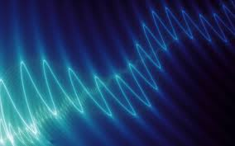
Sound and Hearing
Audio Engineering II

Slide 2
What is sound?
Atmospheric Pressure
Compression and Rarefaction of air molecules
Sound Waves
Air-pressure vibrations that have a repeating pattern are heard as having a pitch, or a musical tone.
Air-pressure vibrations that don’t have a repeating pattern (random) are heard as noise.

Slide 3
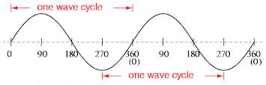
Frequency
The RATE at which a sound wave repeats a cycle.
Frequency is measured in Hertz (Hz)
440 Hz = A4
Human hearing range: 20 – 20,000 Hz (20 Hz – 20 kHz)
Interactive Frequency Range Chart

Slide 4
Harmonics
G
(Linear frequency display)
G
G
G
G
400 Hz
1200 Hz
2000 Hz
2800 Hz
3600 Hz
4400 Hz
5200 Hz
6000 Hz
800 Hz
1600 Hz
2400 Hz
3200 Hz
4000 Hz
4800 Hz
5600 Hz
6400 Hz
1f
2f
3f
4f
5f
6f
7f
8f
9f
10f
11f
12f
13f
14f
15f
16f
Notes:
Slide added for Audio Engineering II
Fundamental – G
Harmonics are every multiple of the fundamental
Every multiple that is a power of 2 (2f, 4f, 8f, etc) is an octave. (It’s also 2x the previous octave)
Stress that this is a linear display of frequency – it would look different on a logarithmic graph.

Slide 5
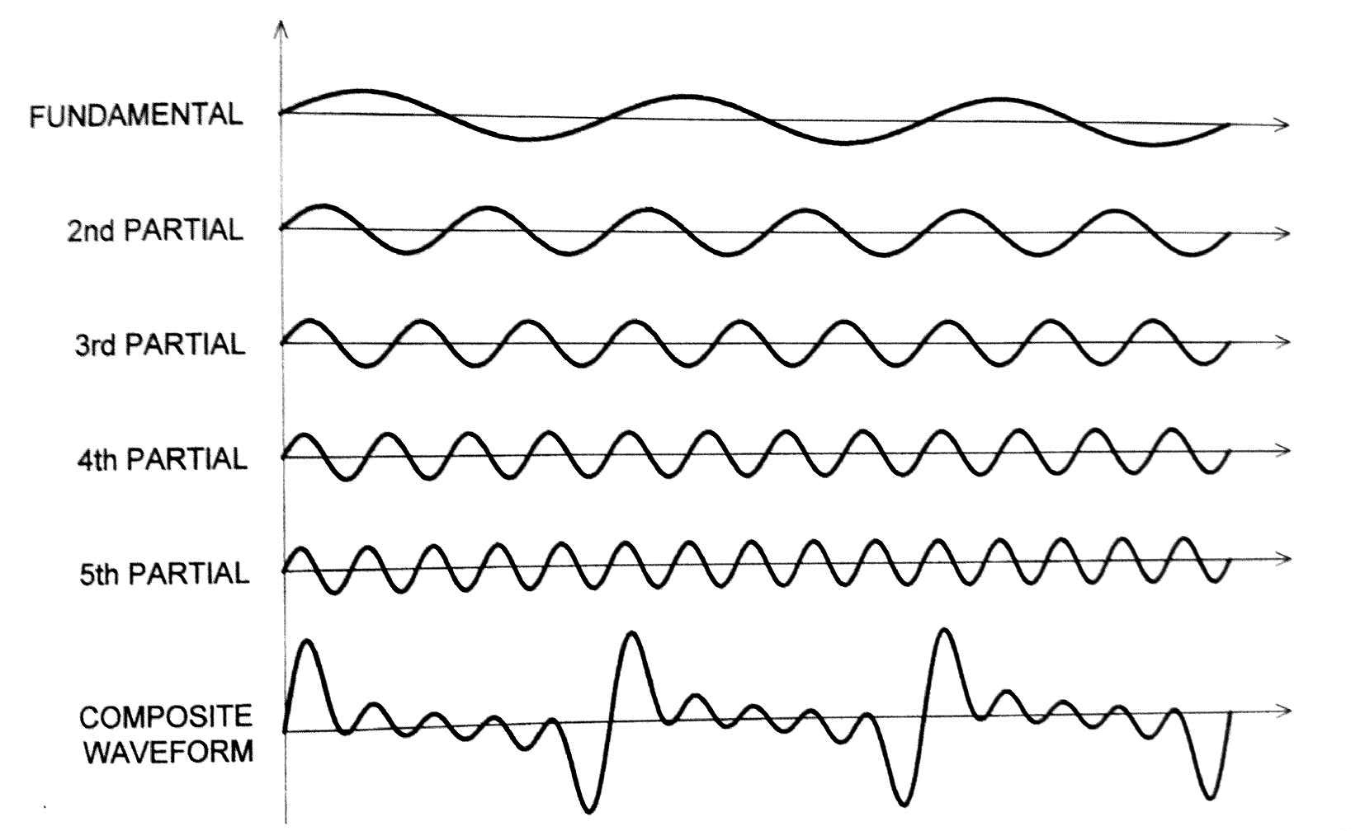
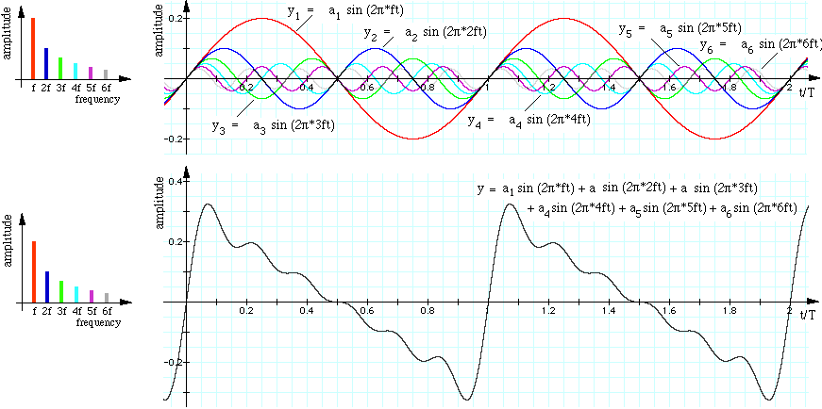
Harmonics
“Harmonics” = “Partials” = “Overtones”
Every periodic sound has harmonics (except a pure sine wave).
The relative volume of the harmonics contributes to the timbre (sound quality) of an instrument. It’s part of the reason we can distinguish, for example, an electric guitar playing 216 Hz from a violin playing 216 Hz.
Notes:
Slide added for AE II

Slide 6
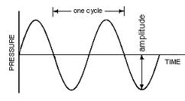
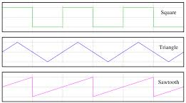
Waveform
A visual representation of a sound wave.
Sine Wave:
Other simple Waveforms:
TERMS:
Amplitude
Frequency
Velocity
Wavelength
Phase
Harmonic Content
Envelope

Slide 7
Wavelength
Velocity of sound:
1130 ft/sec @ 68ºF (±1.1 f/s for each º higher/lower)
Wavelength:
The physical distance of one cycle at a particular frequency
𝛌 = V/f
What is the wavelength of an 800 Hz wave?
1130 ÷ 800 = 1.4125 ft
What is the frequency of a 3.05 ft wave?
f =V/𝛌
1130 ÷ 3.05 = 370 Hz (F#4)

Slide 8
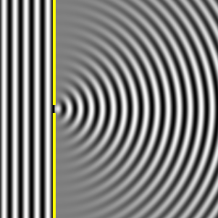
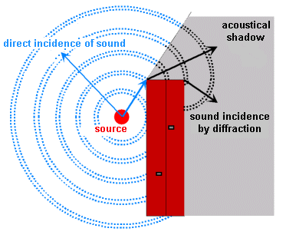
Reflection and Diffraction
Reflection
Sound waves reflect off a smooth, hard surface at the opposite angle.
Sound reflects off corners back towards the origin.
Diffraction
Sound can bend around an obstacle

Slide 9
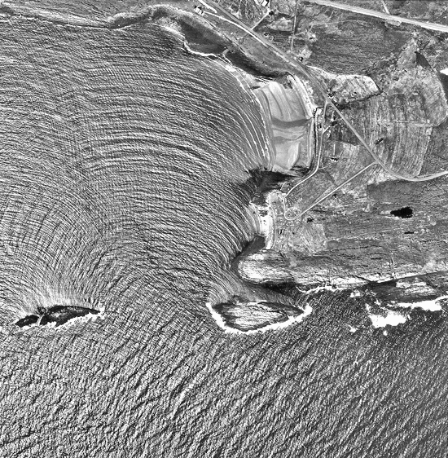

Slide 10
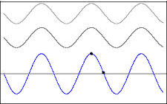
phase
Imagine two sine waves of the same frequency.
When played simultaneously, their waves are combined.
IN PHASE
180º OFFSET
90º OFFSET
Amplitude is doubled
Amplitude is canceled out
Amplitude is same as original
There are two common ways signals can be out of phase: polarity reversal and phase shift…
Notes:
Do Phase Demo – PT session “AE2 Lesson One” – marker 2
Sine wave
Sawtooth wave
Pink noise

Slide 11
Polarity Reversal
Example: Snare drum dual mic setup
An upward vibration is picked up by the top mic as a compression…
And by the bottom mic as a rarefaction.
A downward vibration is picked up by the top mic as a rarefaction…
And by the bottom mic as a compression.
Note: The mic is upside-down, but the signal is not!
Notes:
Open “Keeling” PT session and show drum polarity – zoom in to see the waveform, and listen to the polarity differences.

Slide 12
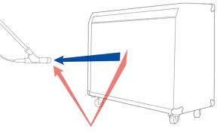
Phase Shift
A delay between two or more waveforms that causes differences in phase between them
Example: a signal picked up by 2 microphones that are placed at different distances.
Some frequencies will be in phase (boosted) and some will be out of phase (cancelled).
Example: a single microphone picking up a direct signal and a reflected signal.
Comb Filtering
Notes:
http://audiogeekzine.com/2010/11/comb-filtering-demonstrated/
Demonstrate on board – which frequencies are out of phase with a 1 ms delay?

Slide 13
Envelope
violin
snare drum
cymbal

Slide 14
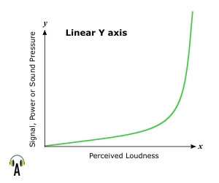
The decibel
The decibel is a way to measure a sound’s loudness, or…
SPL – Sound Pressure Level
We perceive loudness on a logarithmic scale
Dynamic range of human hearing:
The loudest perceivable sound is 10,000,000,000,000 (yup…10 trillion!) times stronger than the quietest perceivable sound.

Slide 15
logarithms
Logarithmic basics
log2 = 0.3
log10 = 1
log100 = 2
log10,000 = 4 (the log of a power of 10 is the number of 0’s)
log1 = 0
log0.1 = -1
log0.01 = -2 (log of a number <1 is a negative number)

Slide 16
Different ways of measuring decibels
A measurement of difference in intensity between two levels
So to measure anything in decibels, we have to first have a reference point to compare with.
1 SPL(_{ref}) is the threshold of hearing – the softest sound humans can perceive.
dB SPL – Measure of sound pressure level in the air
When the distance between a sound and a pickup is doubled, the sound pressure drops by 6 dB.
dBm – (millivolts) Measure of current through an electrical system
This measure is what is most often used with audio devices.
dBFS – Decibels Full Scale – Measurement in reference to the maximum peak voltage level before clipping (distortion) occurs
Core idea:
Turning something up 3 dB will double the signal’s level. (-3 dB halves it)
This doesn’t sound twice as loud, though…
About 6 dB sounds twice as loud.
+10 dB multiplies the signal’s level by 10.

Slide 17
the ear
Threshold of hearing = 0 dB (SPL)
Threshold of pain ≈ 120 dB
Protect your hearing!
Monitor sound at around 85 dB
If you have to raise your voice to be heard over it, limit your exposure.
Take quiet breaks when exposed to levels above 85 dB
Carry earplugs with you often.

Slide 18
The ear’s frequency response
Fletcher-Munson Equal-Loudness Curve
Shows the ear’s sensitivity to different frequencies at different volumes.
Most sensitive to frequencies between 3000-5000 Hz

Slide 19
BEATS
Same principle as phase cancellation and amplification, but now the two sounds are slightly different in pitch

Slide 20
Masking
Louder sounds prevent us from hearing softer sounds
Most prominent when the frequencies of the louder and softer sounds are similar
This is why stereo placement (panning) and equalization (EQ) are important in the mixing process.

Slide 21
Reading
Huber, Modern Recording, pp. 41-66 (7th ed. page numbers)(this is most of chapter 2 – “The Basics of Sound” through “Masking”)

