Slide 1
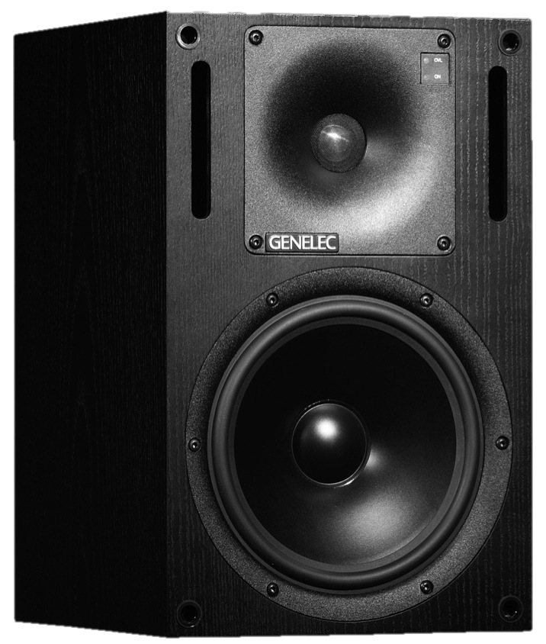
Monitoring
Audio Engineering II
Sources: Huber, Ch. 16; Senior Ch. 1 & 2

Slide 2
Nearfield Monitors
Nearfield Monitors (as opposed to Farfield) came to wide use in the 80s:
  First used as auxiliary monitors for referencing what the mix would sound like on typical home or TV speakers.
  Later caught on and became the main method of monitoring in studios.
One of the most important devices in the studio
  Monitors are our only window to the work we’re doing!
Number of drivers (speaker cones)
  Different driver sizes are more efficient in certain frequency ranges – larger drivers produce better lows and vice versa
  Two-way: two different sized drivers connected by a crossover network
    Divides the frequency spectrum between the two speakers
Active vs. Passive
  Active – the speakers have their own built in amplifier. Active speakers are powered.
  Passive – no built-in amplifier – a separate amplifier must be connected

Slide 3
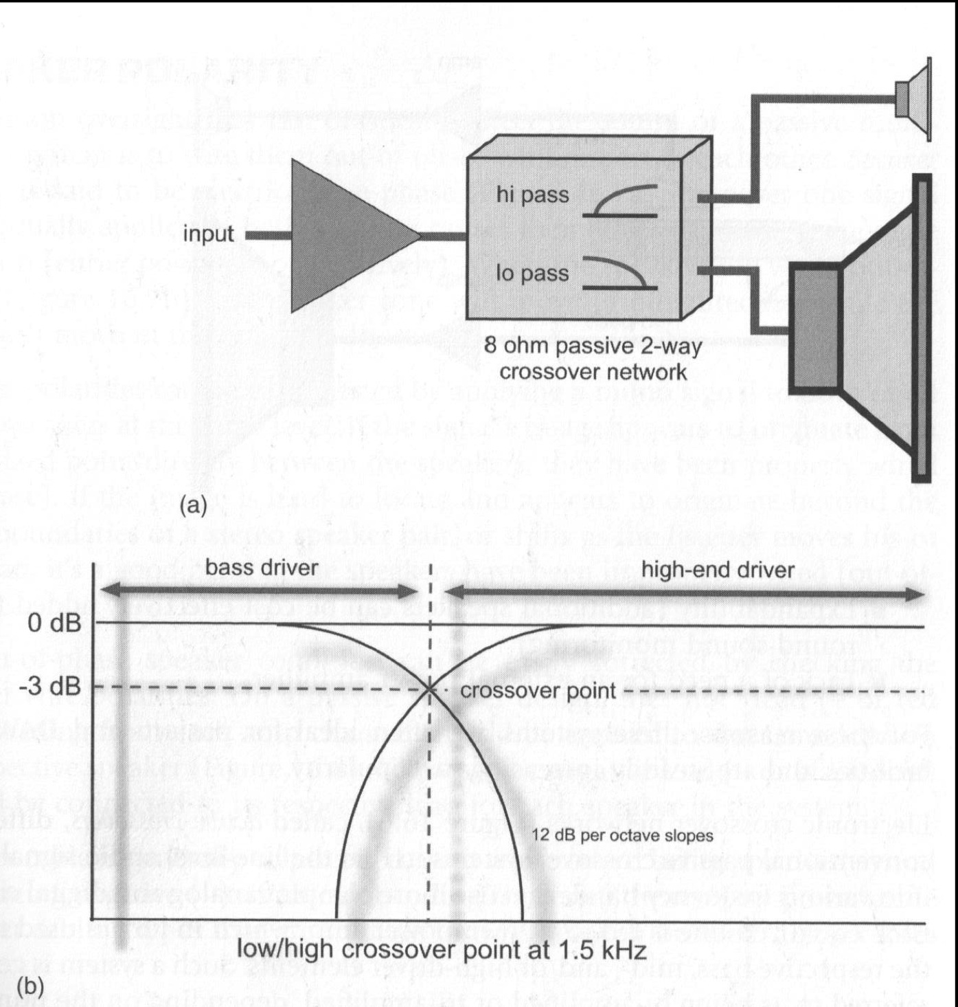
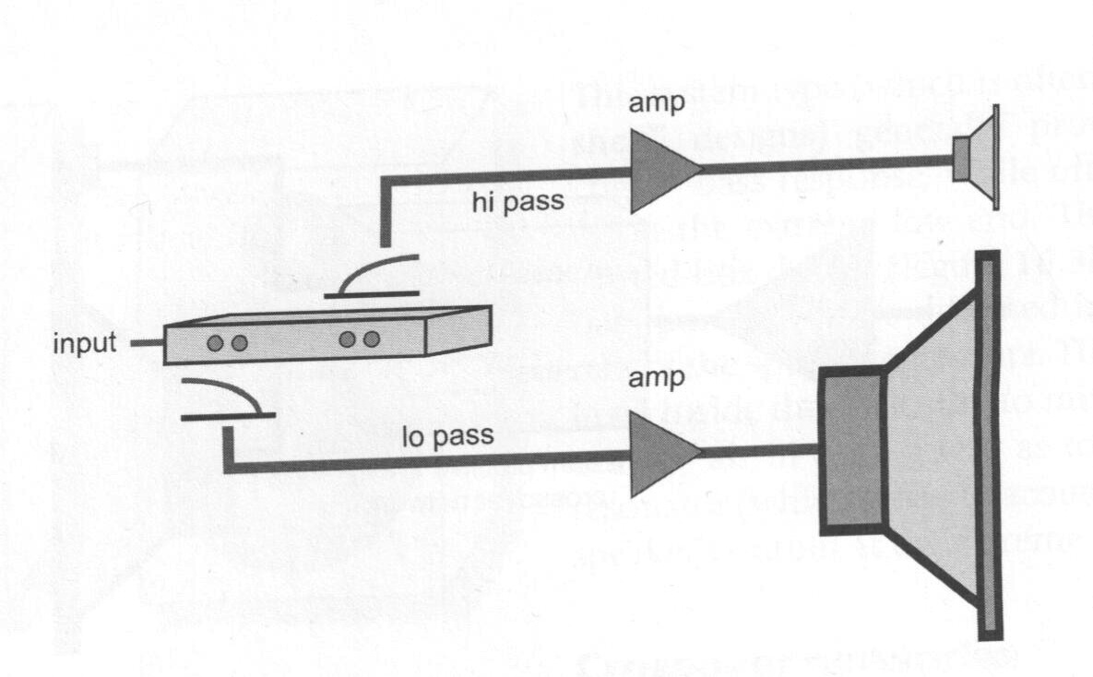
2-way systems
Passive
Active

Slide 4
Nearfield Monitors
2 Body Types
  Air Suspension (non-ported) – air is sealed in. Bass response rolls off.
  Bass Reflex (ported) – air from inside mixes with outside, acting as a resonator

Slide 5
Nearfield Monitors
Factors in choosing the right monitor for your studio:
Flat frequency response possible across all audible frequencies
    No monitor has a completely flat frequency response
Time Domain response
Personal choice
  Some people prefer aggressive-sounding monitors, others prefer more understated ones.

Slide 6
Frequency Response
How useful is it?
A “flat” frequency response would theoretically reproduce all frequencies accurately. You don’t want your speakers accentuating or cutting frequencies that aren’t in your mix.
However, frequency response is measured in anechoic chambers, and doesn’t really take into account the psychoacoustics of listening, or the room reflections we would hear anywhere else.
Psychoacoustically, the time domain is more important than the frequency domain.
Plus, much great music (especially in 60’s and 70’s) has been produced on monitors whose frequency response was all over the place.
Notes:
Time domain vs. frequency domain: compare flute and clarinet samples; first unchanged, then with the first 500ms chopped off. Then apply some mean EQ to the unedited samples – you can still tell them apart. (EQ the edited ones too?)

Slide 7
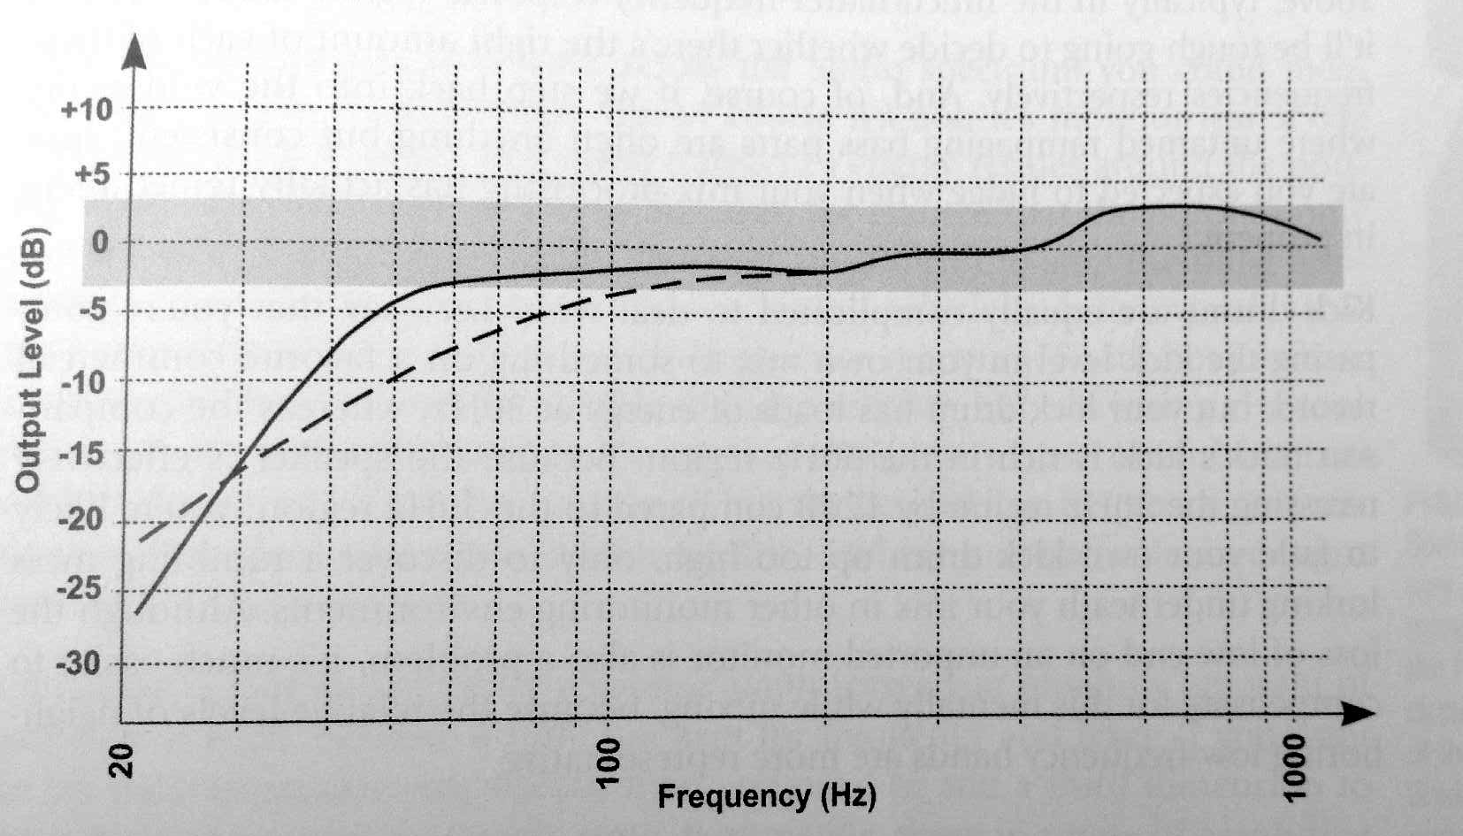
Bass Ports
4. Bass Ports
  The less $$ you have to spend, the more you should beware ported monitors.
    Ports extend the low range of a speaker’s frequency response
    However, they also cause the sub-bass frequencies (i.e. below 50 Hz) to drop off dramatically, which can distort the kick drum and bass volume and tone.
    Ports extend the low range by creating a resonant frequency in the speaker cabinet. However, this frequency will ring out on transients, distorting the any short sound’s decay, as well as any delay and reverb effects.

Slide 8
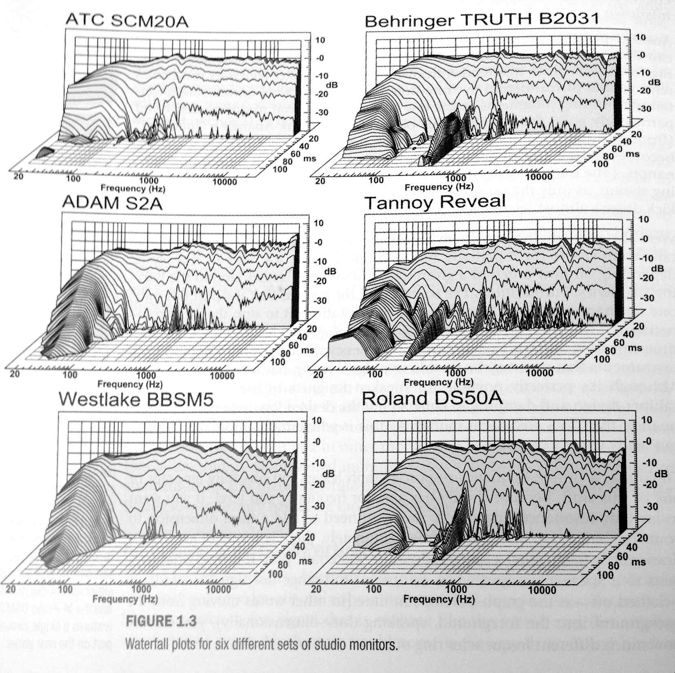
Bass Ports
Budget
Ported
Designs
Non-ported
Ported
Ported

Slide 9
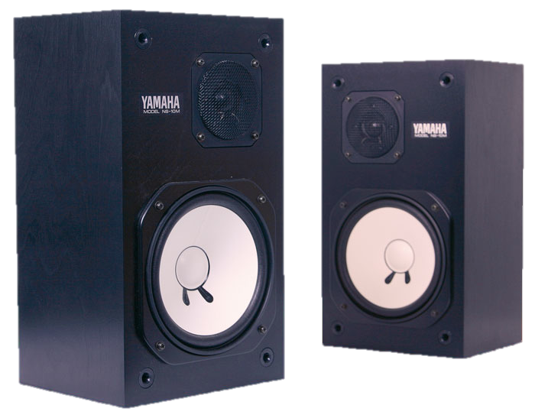
Yamaha NS10
The most celebrated mixing speakers in the music
industry
First manufactured in 1978 as a hi-fi speaker, but wasn’t
successful.
Re-invented as a nearfield monitor, and it took off.
Passive monitor – requires an amp
Discontinued in 2001
Caught on among freelance engineers in the 70’s and 80’s – right at the time when freelance engineers were becoming more numerous.
A well-known research paper was published in 2001 that compared 38 different nearfield monitors, and the NS10 stood out among them in terms of time-domain accuracy.
Closed-box (non-ported) speaker – 12 dB/octave bass roll off below 90 Hz, but flat time-domain response.
  The NS10 has great time-domain accuracy
White driver cone – straight-sided rather than curved
  Less resonant
  Higher frequency response
  Also, it’s instantly recognizable.
Notes:
Anecdotal stories: Bob Clearmountain was one of the first freelance, studio-hopping engineers, and he carried a pair of NS10’s with him.
Some say he picked those because he was looking for the “worst-sounding speakers” he could find. Probably not true…
Other engineers also adopted the NS10 pretty early on, i.e. Bill Scheniman heard a pair at a studio in Tokyo.
Bob Clearmountain also started the common practice of putting tissue paper over the tweeters to dampen the overactive high end slightly. But only the right kind of tissue paper.

Slide 10
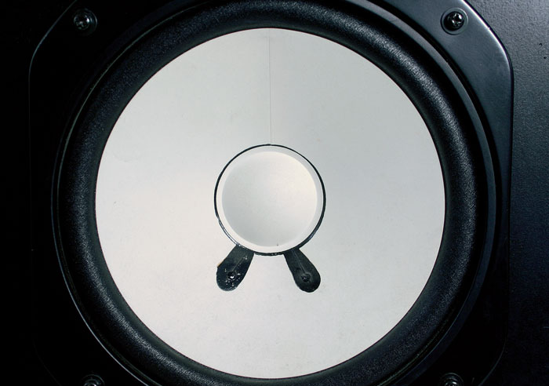
Yamaha NS10

Slide 11
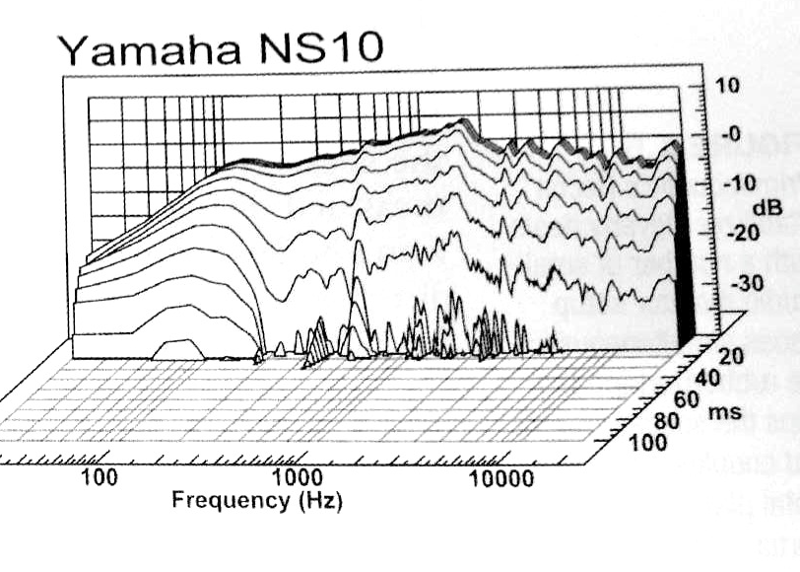
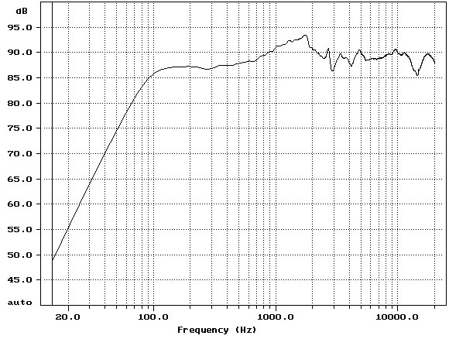
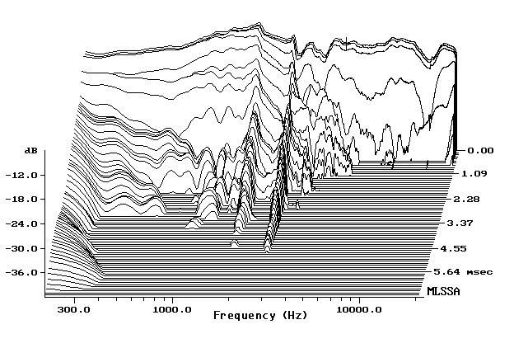
Yamaha NS10
Waterfall plot – time domain accuracy →
Frequency Response

Slide 12
Yamaha NS10
Described as a very revealing monitor
  Midrange-heavy frequency response
  Closed-box cabinet – excellent transient response
    Smooth bass roll-off
  Brings out the flaws in your music
  Some say they sound “terrible.”
  Producers often use them to cross-check mixes
  Video: Miles Walker and the NS10
“I keep NS10s in the studio, because it gives bands and producers a warm feeling. Ten minutes into the session I switch them off and not once has anyone questioned it. I track and mix on better monitors and get better results.”
“The old cliché is that if it sounds good on NS10s then it'll sound good on anything. I think it's precisely because they sound so bad that they are used so widely.”
“I totally hated the NS10s initially and wondered why they were industry standard, until I checked back some mixes on a pair. All the problems instantly jumped out.”
“I don't find the NS10s fatiguing to listen to at all, quite the opposite. The more I use them the more I love them!”
“They're brutally unflattering to mixes, but that's their job. But never, ever use them as a sole pair of monitors. Just a cross check.”
Notes:
http://youtu.be/ggdVckoThp8?t=33s

Slide 13
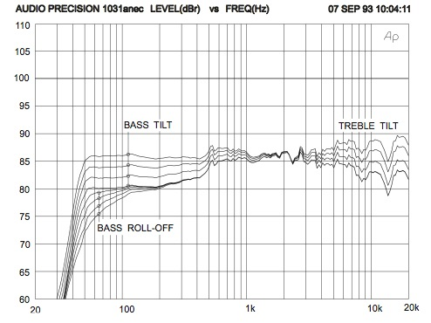
Genelec 1031A
Took over as industry standard nearfield monitor - 1991
Active, two way monitors with bass ports
Known for punchy bass response, aggressive high mid range, and great imaging.
  The aggressive frequency ranges are seen by some as too “flattering” to the music. Not a perfectly flat frequency response.
No longer available new
  Alternatives: Genelec 8050 - $1345; M040 - $895

Slide 14
Choosing Monitors
There are MANY choices of high-quality monitors out there.
Besides the guidelines listed above, the best advice is:
Choose a pair and get used to the way they sound. The better you know how your monitors sound, the better you can identify problems in your mix.

Slide 15
Speaker Placement
To tap into your monitors’ full sonic potential, placement is extremely important.
Mounting hardware should:
  Be firm and solid – high inertia keeps the speaker from moving in reaction to its own low-frequency vibrations.
  Minimize the transmission of vibrations from the speaker into other resonant objects.
Speaker stands are great for both of these purposes.
  If hollow, can be filled with sand to increase inertia and damp resonances.
Desks and wall shelves are OK but are more likely to resonate with certain frequencies.
  Play low frequency test tones and listen/touch to test for resonant vibrations in furniture or walls.

Slide 16
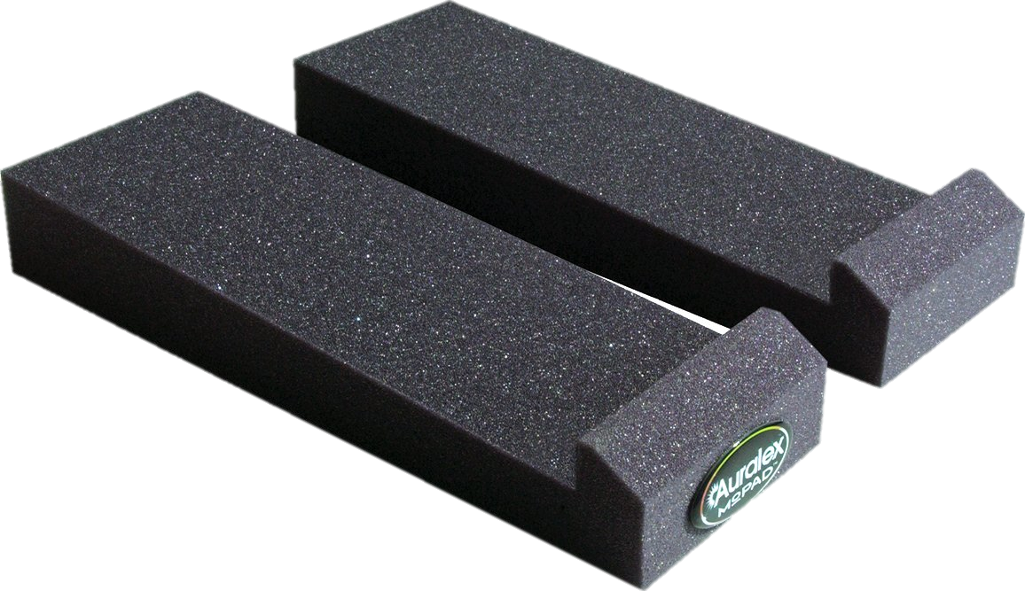
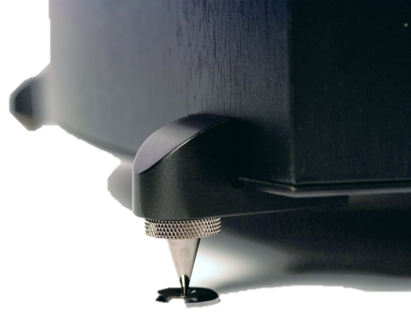
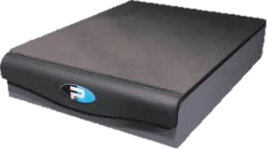
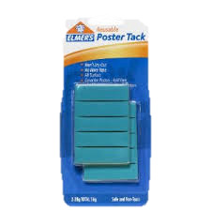
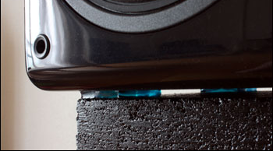
Speaker Placement
Eliminating resonant vibrations:
Place speakers on an object that decouples them from the resonant object they’re sitting on
  Auralex Mo Pads
  Spikes
  Primacoustic Recoil
  Stabilizer
  DIY possibilities:
    Sticky Tacky
    Silica Gel Pads
    Mouse Pad
    Pencil Erasers
    Felt cymbal pads
    Small rocks
    Etc.!
Notes:
DIY Options: Sticky Tacky, Silica Gel Pads, Mouse Pad, Pencil Erasers, Felt Pads from Cymbal Stands, Small rocks!

Slide 17
Speaker Placement
Point monitors directly at the listening position
  Horizontal placement
  Vertical placement
    If your monitors have two drivers, position it so that the listening position is exactly halfway between the two, to avoid frequency cancellation problems.
Distance between speakers = distance from each speaker to listener
Speakers not too far apart – it’s better to err on the side of being too close together.
60º
Notes:
Listening test: Play Pinknoise through one speaker. Move left/right and notice the sonic change. Move up/down and notice – it’s probably more noticeable.

Slide 18
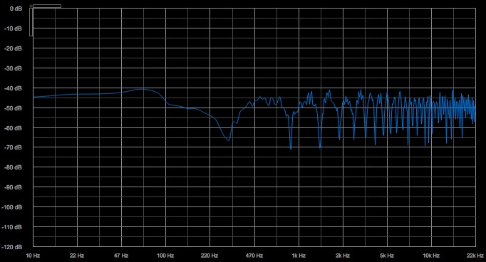
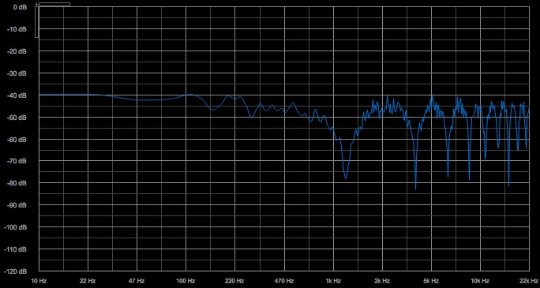
Boundary Effect
As you move a speaker closer and closer to a boundary, the delay between the direct sound and the reflected sound decreases.
  The two signals become less and less out-of-phase.
2 ft.
6 in.

Slide 19
Boundary Effect
Comb filtering reduces as a speaker gets closer to a boundary, and low frequencies begin to be reinforced more, for two reasons:
  Longer wavelengths shift less at a given delay than higher frequencies
  Low frequencies are transmitted better by a speaker off-axis.
2.5 ms
2.5 ms

Slide 20
Boundary Effect
Some speakers have a low-cut switch to compensate for boundary-related low-end boost.
Bass-trapping acoustic treatment can help diminish the reflections somewhat.
However, the best solution is to simply avoid placing speakers too close to walls and other boundaries.

Slide 21
Main points:
For the ability to produce commercial-grade results:
Avoid monitors with bass ports unless you can spend at least ~$1200 on them.
Place speakers on solid, non-resonant surfaces, away from boundaries.
Place speakers in an equilateral triangle with the listening position, and align them both vertically and horizontally.
Plan to spend the same amount on acoustic treatment as on the monitors themselves (unless you DIY a lot of the acoustic treatment)
  Acoustic foam
  Diffusers
  Bass traps
Don’t overdo the acoustic foam, deadening the high frequencies. It’s hard to overdo bass trapping, though.

Slide 22
Nearfield Monitoring
Phantom Center
  Often, dead-center images feel less stable than hard-panned ones.
    Speaker calibration
    Room reflections and resonances
Monitoring on carefully configured studio nearfields won’t sound like the majority of systems your project will be heard on. The main reasons for being extra-conscious of details in your monitoring setup are:
  Having an accurate idea of what’s going on across the whole frequency spectrum, especially at the extremes
  Judging sound quality as you apply processing
  Evaluating and adjusting the stereo image
  Understanding how your mix will sound on hi-fi systems
For anything else, supplemental monitoring is most helpful.
Notes:
.4. Speaker Test: use StereoTest file and listen to how the left/right noise bursts are a little “narrower and more precise” than the phantom center image.
Also play Madonna – American Life – compare the imaging of the lead vocal at the chorus, with the left-panned synth at :45 and the right-panned guitar at :55.

Slide 23
Supplemental Monitoring

Slide 24
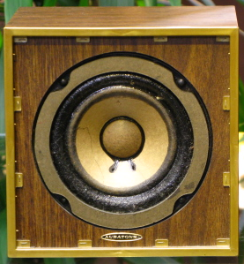
Auratone 5C Super Sound Cube
Like the Yamaha NS10, a classic and iconic nearfield monitor.
Not produced anymore, so if you want to tap into what they have to offer, it’s important to understand their features and find modern replacements.

Slide 25
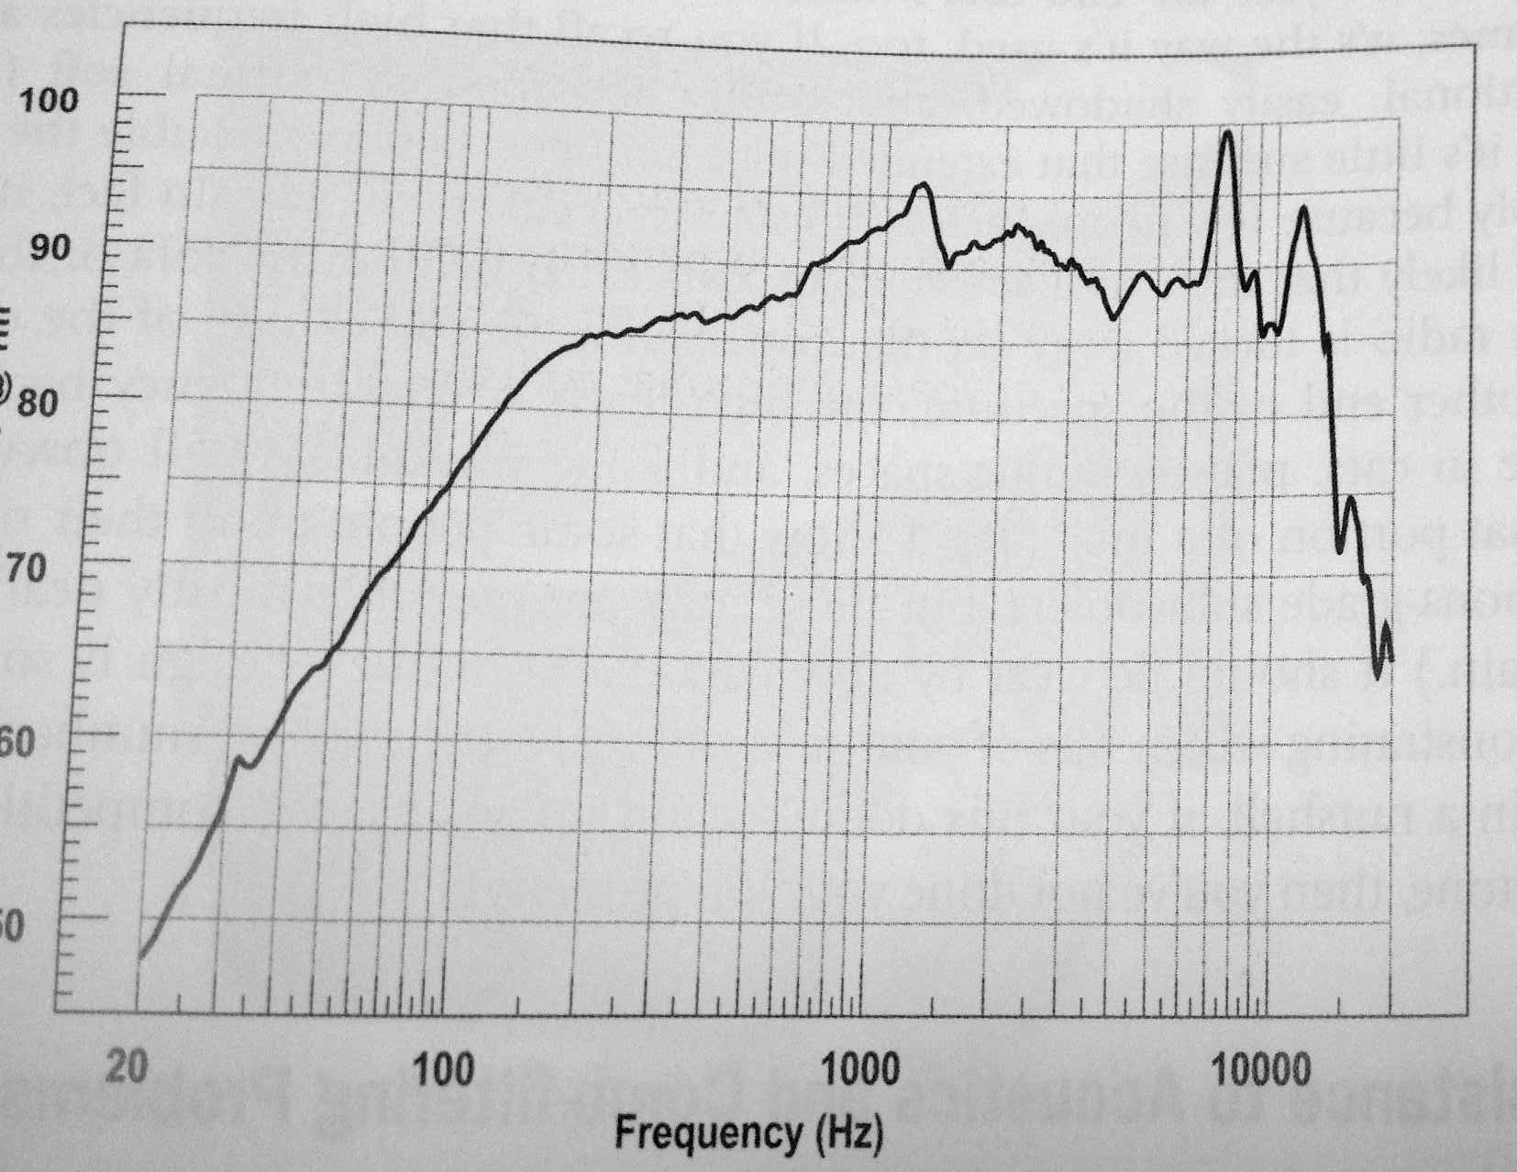
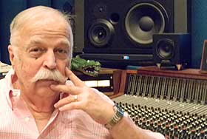
Auratone 5C Super Sound Cube
Thriller (the top-selling record of all time) was mixed on Auratones.
  “I love Auratones! … There’s no hype with an Auratone… Probably 80 percent of the mix is done on Auratones, and then I’ll have a final listen or two on the big speakers.”
      ~Bruce Swedien
The soundtrack to Saturday Night Fever was also mixed on Auratones.

Slide 26
Auratone 5C Super Sound Cube
Portless – limited bass response
One way (single driver) – detracts from high-frequency efficiency
  Also eliminates the crossover between two drivers that could cause comb filtering in certain frequency ranges.
Restricted frequency range focuses your ears on the midrange
  Midrange is where most of the musical material lies and is what will be translated best to any other system.
Think of how many everyday consumer playback systems out there have one-driver designs:
  Small radios, phones, TVs, computer speakers, PA systems, etc.
Limited bass response takes room modes out of the equation

Slide 27
Mono Compatibility
Many engineers will listen to their mix on a single Auratone to hear how it sounds in mono.
  Anything dead center (phantom center) will be boosted by 3 dB.
  When you mix in stereo, you can move things around in the stereo field to keep them from interfering with one another.
  In mono, the only option you have is relative volume across the frequency range (level and EQ)
  Phase problems show up in mono
    Stereo recordings where one mic was closer to the source than another – phase shift
    Effects and synth patches that invert the phase of one channel for stereo widening effects – inverted polarity
    Reverb and very short delays can also have some comb filtering
Notes:
.5. Mono Balance Shift file – listen with Test track output to Cue|24 first – level is equal as it moves back and forth. Then switch output to bus 7, which is routed thru a mono aux track.
.6. Drum Overheads Stereo Phase – in mono the high end is weakened.
.7. Synth pad stereo phase file – no explanation needed…

Slide 28
Why listen in mono?
Practically all music, TV/radio broadcast, etc. is produced in stereo (at least)…
Stereo effects get lost in most listening environments
  Unless you’re in the sweet spot, a lot of stereo image will default to the nearest speaker.
  Most listening environments don’t even have a sweet spot to speak of!
  Many other situations where mono is all you get.
    Any PA system
    Even cars don’t have that great of stereo imaging.

Slide 29
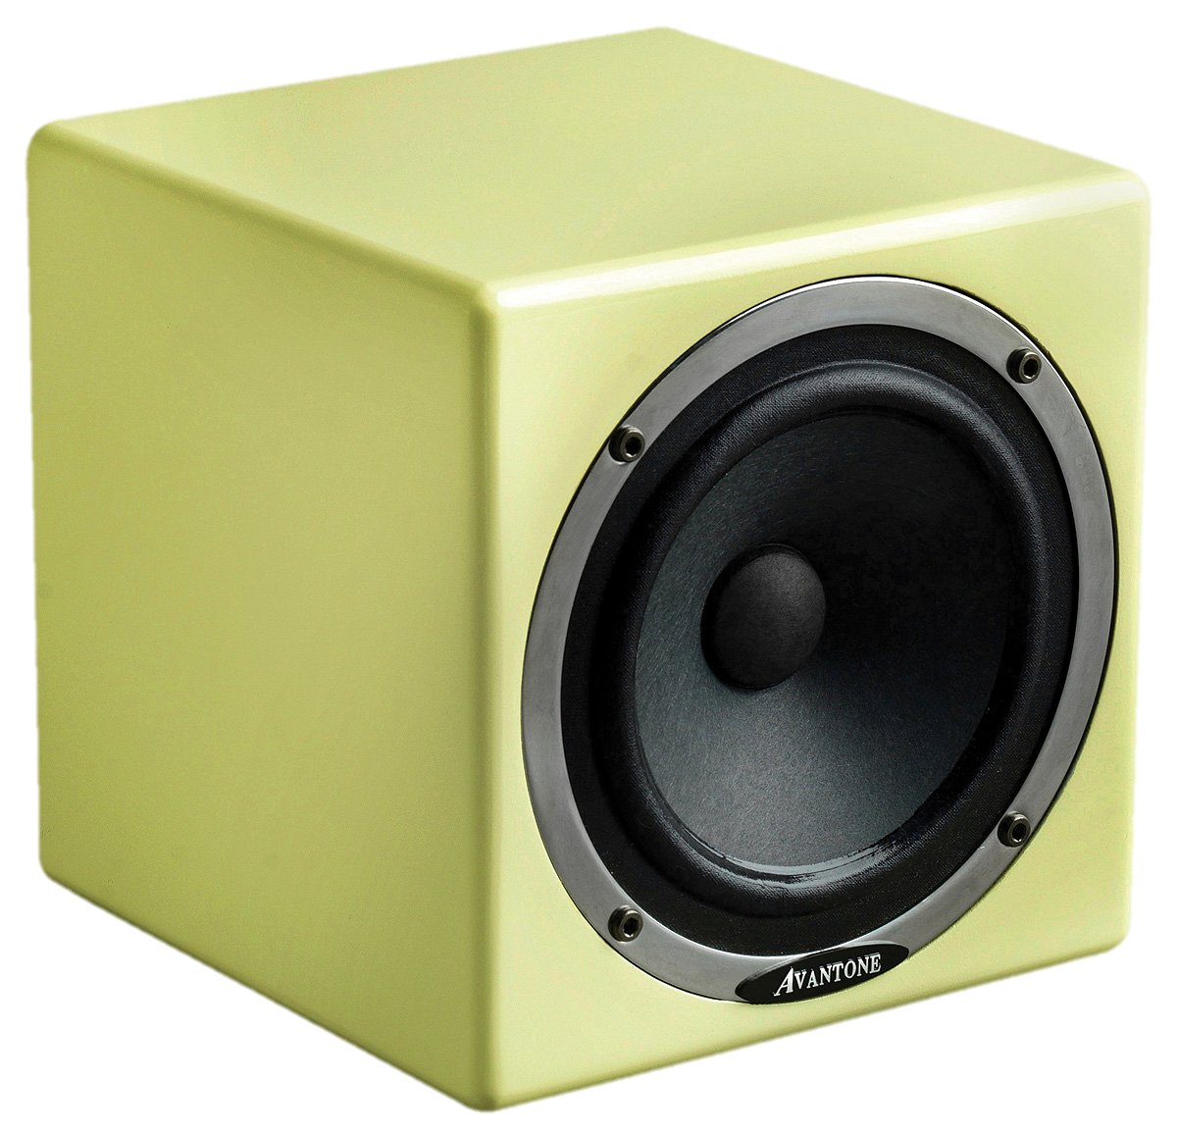
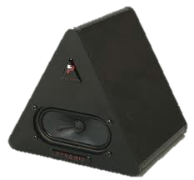
Auratone Substitutes
The Auratone became widespread not because it sounded like the worst possible speaker system, but because it highlights midrange focus and works really well for secondary monitoring – focusing on midrange, and spotting balance and mono-compatibility issues.
  Low distortion for its size
  Relatively low treble for its size
  Very smooth bass roll-off
Avantone Mix Cube
  $469/pair (active)
  Slightly flatter and wider frequency response
Pyramid Triple P
Canford Diecast Speaker
DIY

Slide 30
Headphones
Because headphones play to each ear exclusively, you get a much wider stereo field.
Headphone listening also bypasses room-related problems – background noise, room modes and reflections, etc.
  $75 will get you all the fidelity you need
  High-end studio headphones could be up to $500
Bass response is still not accurate though.
180º
60º
Notes:
Why not use headphones instead of nearfields?
Bass Response
Speed – headphone mixing can get you bogged down in details (ironically) because of the wider stereo image and more exposed details. Nearfields are really the reference point, and headphones don’t sound the same.

Slide 31
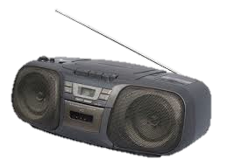
Grotboxes
“Unashamedly cheap mass-market speakers that let you hear how your mix holds up in the face of serious playback abuse.”
Cheap PC speakers or boomboxes are great for this
Place close together so they come across as mono mix but without the boost that centered signals get in mono.

Slide 32
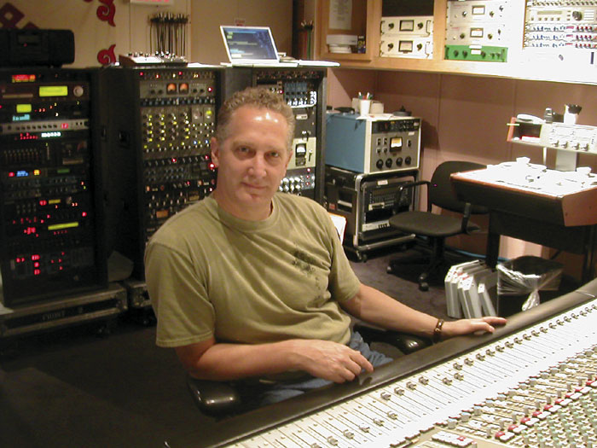
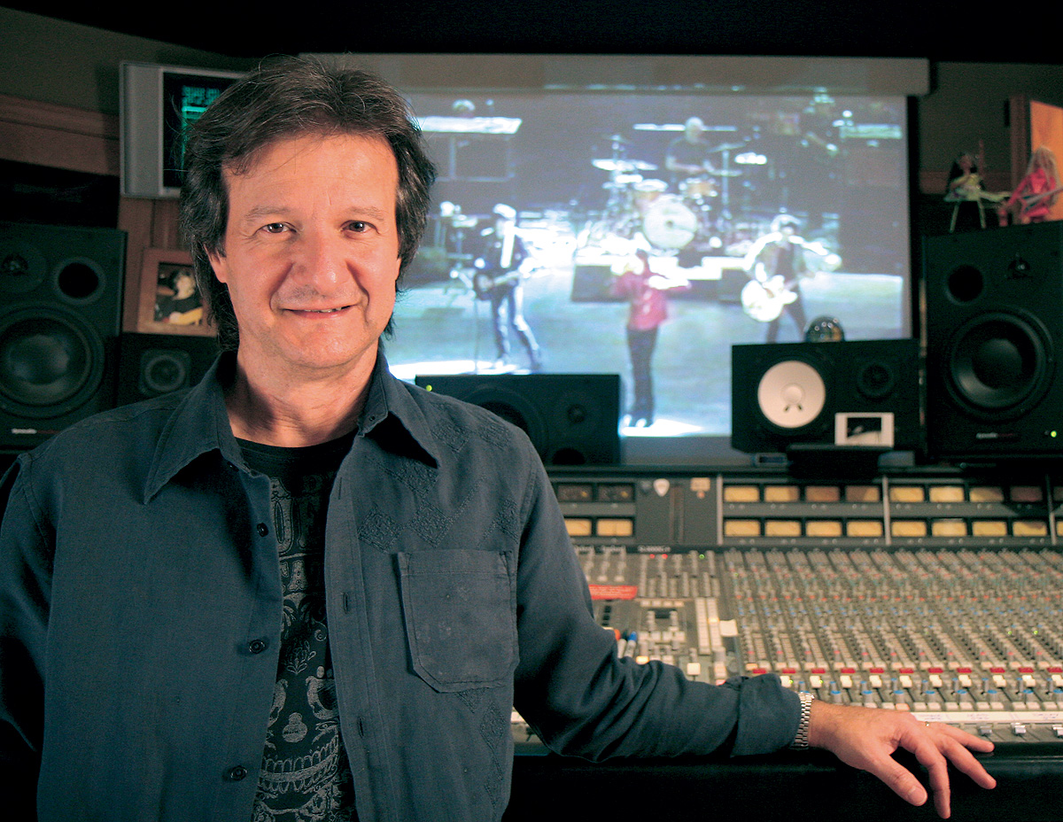
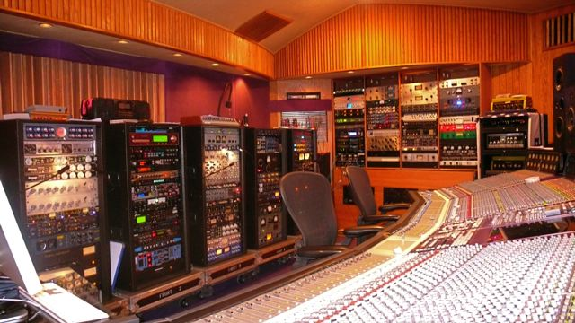
Grotboxes
Bob Clearmountain uses a pair of Apple computer speakers
Michael Brauer uses a Sony boombox

Slide 33
Low End Management
Learn what room modes cause problems in the studio.
  Listen from different spots in the room, focusing on bass level.
  Even listen from the doorway into another room
Sub-sonic energy buildup
  Can hinder the overall loudness level
  Can create distortion on some playback systems
    Watch the speaker cones for large woofer excursions
    Use a spectrum analyzer to see the track’s frequency content
    “P, B, and W” sounds
    Performers’ motion, environmental rumble, etc.
      Snare (leakage from kick), Acoustic Guitar (pick noise and motion), Vocals
Place high-pass filters on all tracks
    Most instruments can be cut out below 100 or 120 Hz.
“You’ve got to remember that the stuff that’s going to take up the most room in your mix is on the bottom end. If you just let the bass take up that space, you can get out a lot of the low stuff on other tracks—up to around 160 Hz—and it will still sound massive.” –Jack Douglas
Notes:
Cone Flapper Test File

