Slide 1
Studio Acoustics
Audio Engineering II
Sources:
Senior, Ch. 1
The SOS Guide to Acoustic Treatment
Huber, Ch. 3

Slide 2
Rule 1:
THE ROOM IS AT LEAST AS IMPORTANT AS THE SPEAKERS!
Even on a shoestring budget, you can make vital acoustic improvements.
Two main sources of problems caused by the room:
Reflections of mid and high frequencies off hard surfaces
Peaks and troughs in the low end response caused by reflections of low frequencies

Slide 3
Early Reflections
Any surface within 3 meters of your speakers
Desk or mixing console
Walls
Ceiling/Floor
Early reflections – delayed signal combines with the direct signal, causing comb filtering.
Professional studios – walls are angled to bounce reflections away from the listening position
Smaller studios – acoustic foam can absorb reflections – this will dampen them to a softer level so they don’t interfere as much with the direct sound.

Slide 4
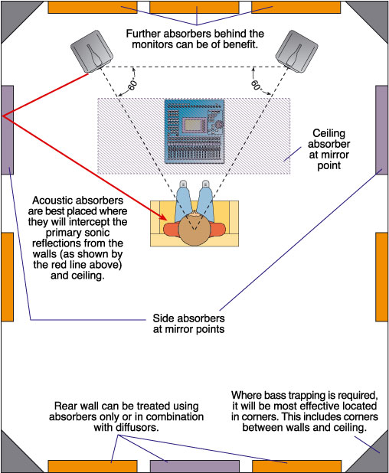
Acoustic Foam
Mirror points: put foam at points on the walls where sound is reflected from the speaker to the listener.
You can find these points by using a mirror.
Front and back walls and ceiling too

Slide 5
Acoustic Foam
Auralex foam
DIY - High-density insulation
Needs to be covered – it’s fiberglass
Curtains or blankets
Leave a few inches between the wall and the curtain
Diffusers
Diffusers can be more expensive, but other things can work – i.e. bookshelves or CD racks
Back wall behind monitors

Slide 6
Acoustic Treatment
Foam is only effective at absorbing mid- to high frequencies, and its thickness determines its effectiveness
2-inch thick foam is only effective above 400-600 Hz.
4-inch thick foam is only effective above 200-300 Hz.
Spacing foam/insulation panels away from the wall by a few inches will increase its effectiveness at lower frequencies.
Tip: glue the foam to a plywood frame instead of directly to the wall. Then it can be moved later.

Slide 7
Acoustic Foam – in moderation!
Avoid the temptation to cover the whole room in foam or absorptive material.
It would deaden the room’s natural reverb.
It would also kill any resemblance to a real-world listening environment.
Plus, it would be expensive!

Slide 8
Diffusion
Another way to reduce interference from early reflections: install diffusers.
Diffusers scatter reflections in many directions, making them less obtrusive.
The greater the difference between long and short pieces, the lower the frequency it is effective at.
Diffusers can be more expensive than foam, but you can achieve similar results with a bookcase or CD rack, or you can make them yourself.
DIY Diffuser
Notes:
http://www.pmerecords.com/Diffusor.cfm

Slide 9
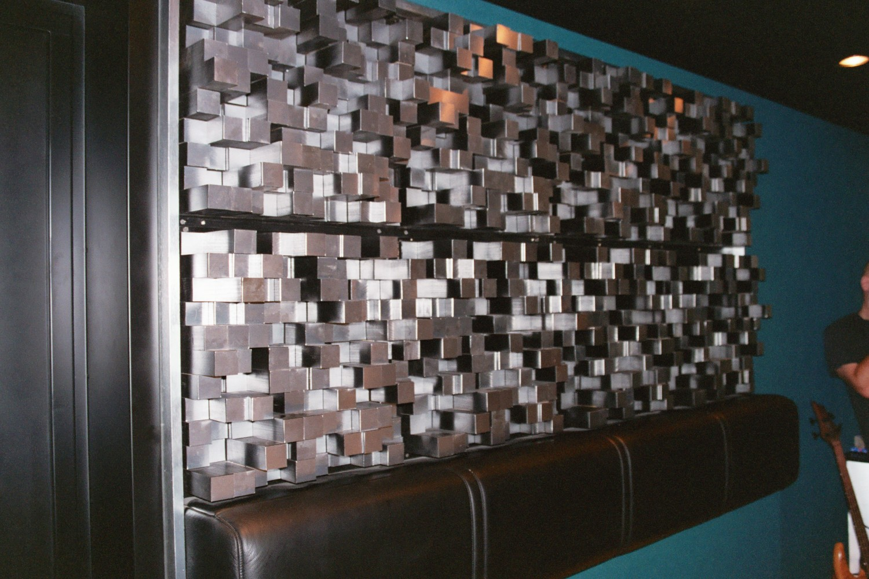
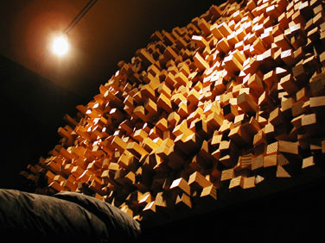
Diffusion

Slide 10
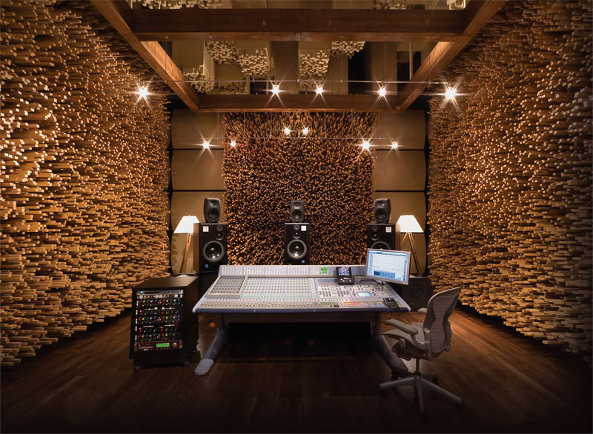

Slide 11
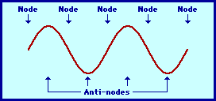
Room Resonance
Mode: yet another synonym for harmonics/overtones/partials.
We use the term “modes” when describing the vibrational properties of sound waves.
Node: a point along a vibrating wave that is still (for a certain frequency)
Antinode: a point along a vibrating wave that moves the maximum amount (for a certain frequency)

Slide 12
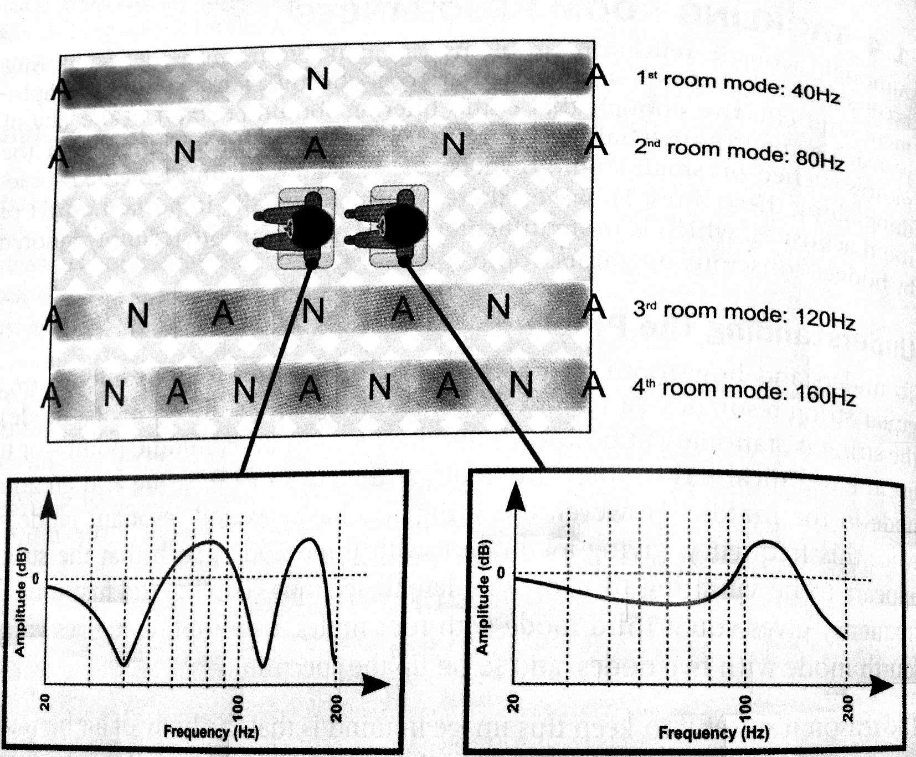
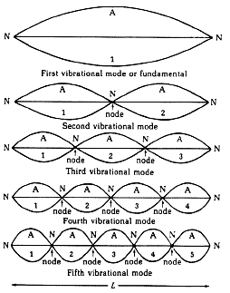
Room Resonance (a.k.a. Standing Waves)
A single room mode can boost/cut its resonant frequency by as much as 20 dB!

Slide 13
Room Resonance
To find the resonant frequency between two walls:
565 / Distance in feet
Room modes will be at multiples of this frequency.
If the mode has a node in your listening spot, you’ll hear a dip at that frequency range.
If the mode has an antinode in your listening spot, you’ll hear a boost at that frequency.

Slide 14
Avoiding Room Resonances
The professional solution is to build rooms with non-parallel walls.
For the rest of us:
Avoid small rooms if possible
Choose a rectangular room rather than a square room
Avoid setting up your listening position exactly halfway between walls
You don’t want to be too far off-center either, though. But stereo imbalance is not as big of an issue as room modes.
Bass Traps!

Slide 15
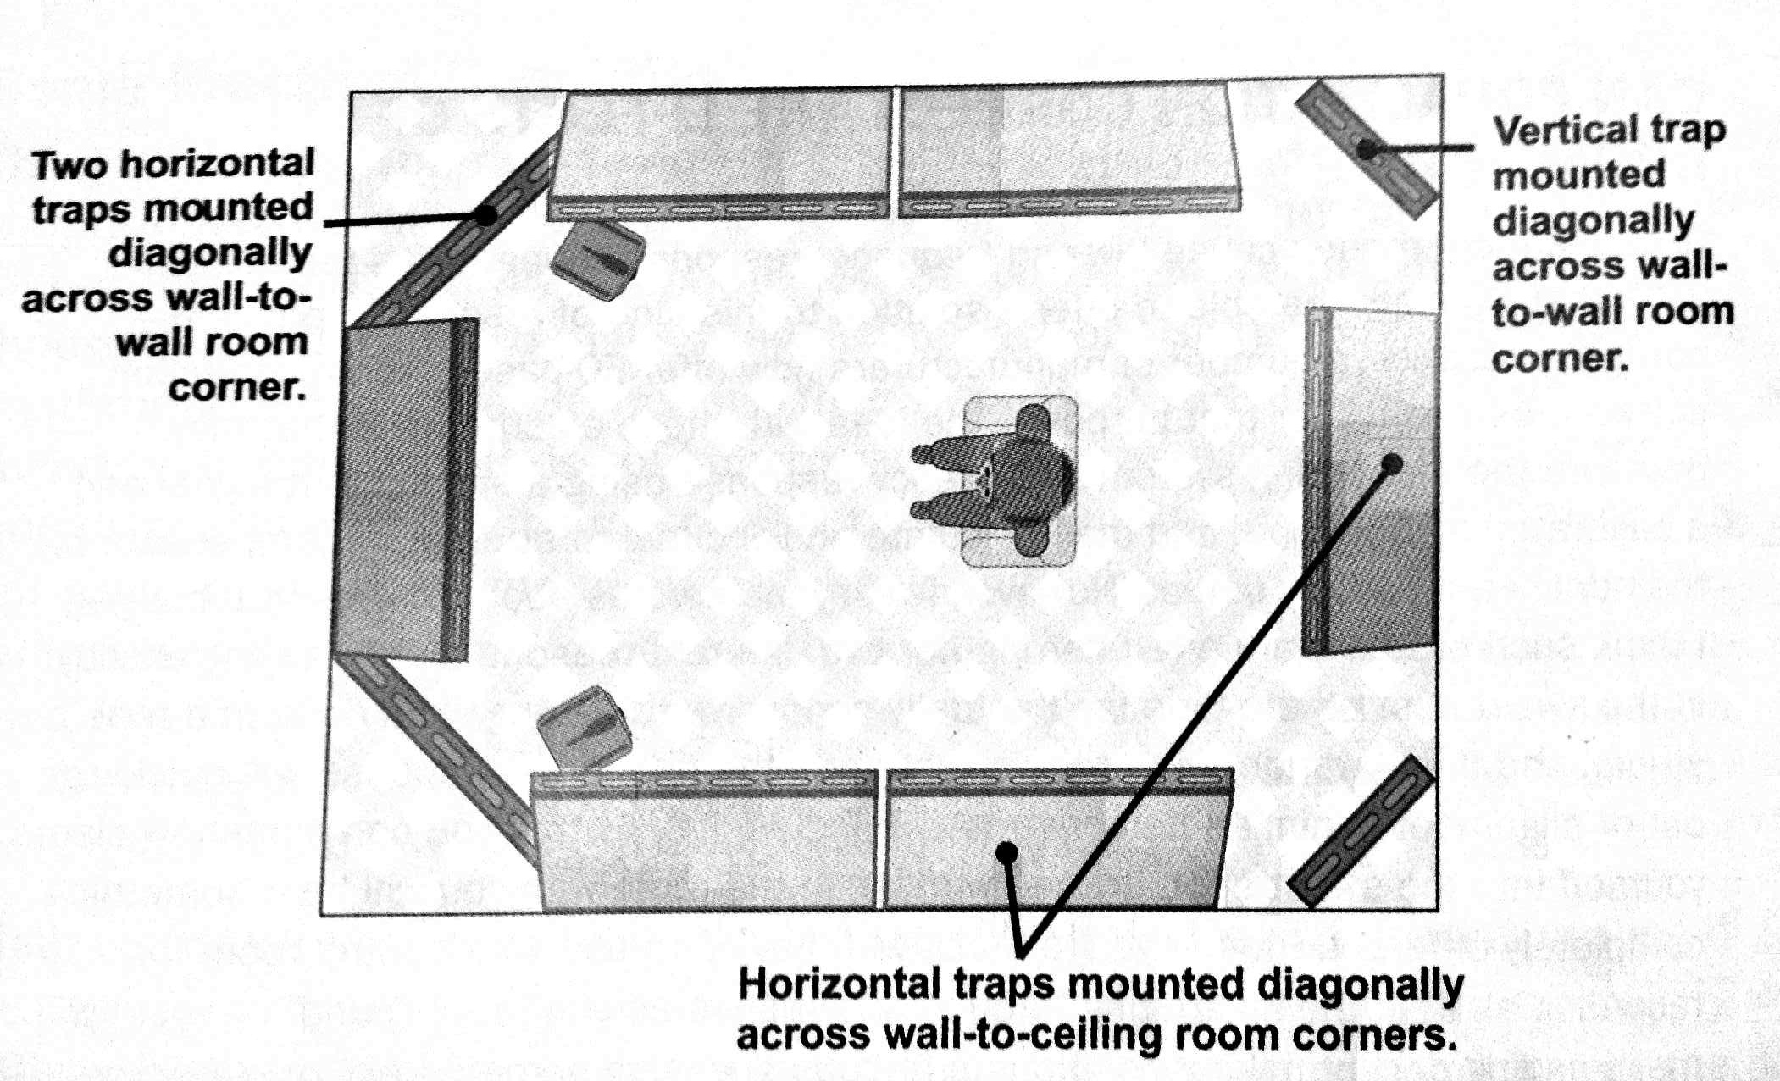
Bass Traps
Large panels of thick (4-inches thick or more), dense mineral fiber
Corners are a common place for them because bass multiplies in corners.

Slide 16
Boundary Effects
If speakers are placed close to walls, low frequencies will be reinforced by reflections.
Longer wavelengths cause them to be less out-of-phase from the delay
Low frequencies are stronger off-axis (from the sides/back of speakers).
The effect is doubled in corners.
Solutions:
EQ the speakers (some speakers have low-cut filters)
Just don’t place speakers near walls!

